Slide 1
The lecture 7
Thread synchronization with Lock and RLock

Slide 2
Thread synchronization
When two or more operations belonging to concurrent threads try to access the shared memory and at least one of them has the power to change the status of the data without a proper synchronization mechanism a race condition can occur and it can produce invalid code execution and bugs and unexpected behavior.
The easiest way to get around the race conditions is the use of a lock. The operation of a lock is simple; when a thread wants to access a portion of shared memory, it must necessarily acquire a lock on that portion prior to using it. In addition to this, after completing its operation, the thread must release the lock that was previously obtained so that a portion of the shared memory is available for any other threads that want to use it.
In this way, it is evident that the impossibility of incurring races is critical as the need of the lock for the thread requires that at a given instant, only a given thread can use this part of the shared memory. Despite their simplicity, the use of a lock works.
However, in practice, we can see how this approach can often lead the execution to a bad situation of deadlock. A deadlock occurs due to the acquisition of a lock from different threads; it is impossible to proceed with the execution of operations since the various locks between them block access to the resources.

Slide 3
Thread synchronization

Slide 4
Locks
The following example demonstrates how you can manage a thread through the mechanism of lock(). In this code, we have two functions: increment() and decrement(), respectively. The first function increments the value of the shared resource, while the second function decrements the value, where each function is inserted in a suitable thread. In addition to this, each function has a loop in which the increase or decrease is repeated. We want to make sure, through the proper management of the shared resources, that the result of the execution is equal to the value of the shared variable that is initialized to zero.

Slide 5
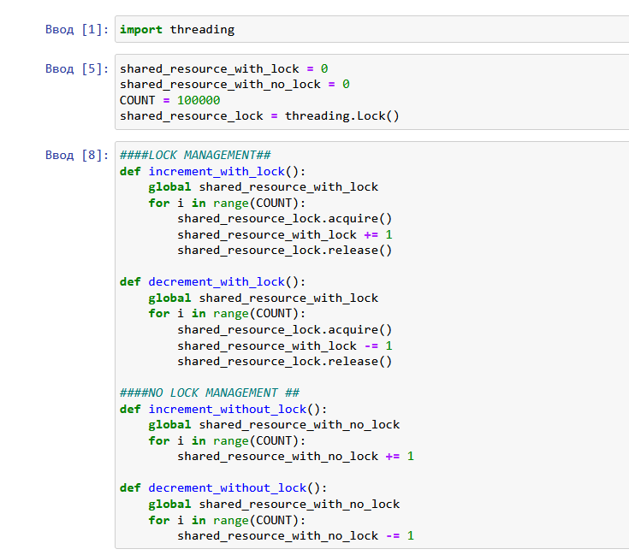
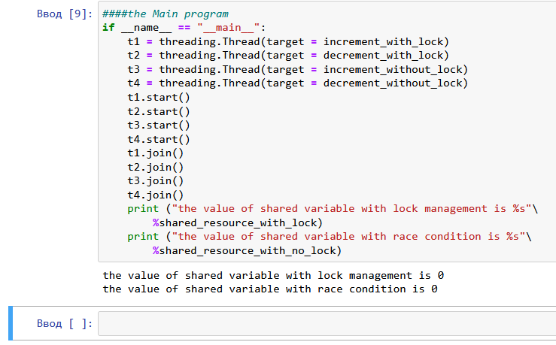
Locks

Slide 6
locks
In the main method, we have the following procedures:
t1 = threading.Thread(target = increment_with_lock)
t2 = threading.Thread(target = decrement_with_lock)
For thread starting, use:
t1.start()
t2.start()
For thread joining, use:
t1.join()
t2.join()
In the increment_with_lock() and decrement_with_lock()functions, you can see how to use lock management. When you need to access the resource, call acquire() to hold the lock (this will wait for the lock to be released, if necessary) and call release() to release it:
shared_resource_lock.acquire()
shared_resource_with_lock -= 1
shared_resource_lock.release()

Slide 7
locks
Let's recap:
Locks have two states: locked and unlocked
We have two methods that are used to manipulate the locks: acquire() and release()
The following are the rules:
If the state is unlocked, a call to acquire() changes the state to locked
If the state is locked, a call to acquire() blocks until another thread calls release()
If the state is unlocked, a call to release() raises a RuntimeError exception
If the state is locked, a call to release() changes the state to unlocked

Slide 8
Drawbacks of locks
Despite their theoretical smooth running, the locks are not only subject to harmful situations of deadlock, but also have many other negative aspects for the application as a whole. This is a conservative approach which, by its nature, often introduces unnecessary overhead; it also limits the scalability of the code and its readability. Furthermore, the use of a lock is decidedly in conflict with the possible need to impose the priority of access to the memory shared by the various processes. Finally, from a practical point of view, an application containing a lock presents considerable difficulties when searching for errors (debugging). In conclusion, it would be appropriate to use alternative methods to ensure synchronized access to shared memory and avoid race conditions.

